Slide 1

Chapter 2
Application Layer
A note on the use of these PowerPoint slides:
We’re making these slides freely available to all (faculty, students, readers). They’re in PowerPoint form so you see the animations; and can add, modify, and delete slides (including this one) and slide content to suit your needs. They obviously represent a lot of work on our part. In return for use, we only ask the following:
If you use these slides (e.g., in a class) that you mention their source (after all, we’d like people to use our book!)
If you post any slides on a www site, that you note that they are adapted from (or perhaps identical to) our slides, and note our copyright of this material.
For a revision history, see the slide note for this page.
Thanks and enjoy! JFK/KWR
All material copyright 1996-2020
J.F Kurose and K.W. Ross, All Rights Reserved
Computer Networking: A Top-Down Approach
8th edition n
Jim Kurose, Keith Ross
Pearson, 2020
Notes:
Version History
8.1. Updates throughout, including a lot more animations. These are the ppt files used to make Chapter 2 online lectures in Sept. 2020.
8.0 (April 2020)
All slides reformatted for 16:9 aspect ratio
All slides updated to 8th edition material
Use of Calibri font, rather that Gill Sans MT
Add LOTS more animation throughout

Slide 2

Application layer: overview
P2P applications
video streaming and content distribution networks
socket programming with UDP and TCP
Principles of network applications
Web and HTTP
E-mail, SMTP, IMAP
The Domain Name System DNS

Slide 3
Application layer: overview
Our goals:
conceptual and implementation aspects of application-layer protocols
  transport-layer service models
  client-server paradigm
  peer-to-peer paradigm
learn about protocols by examining popular application-layer protocols and infrastructure
  HTTP
  SMTP, IMAP
  DNS
  video streaming systems, CDNs
programming network applications
  socket API

Slide 4
Some network apps
social networking
Web
text messaging
e-mail
multi-user network games
streaming stored video (YouTube, Hulu, Netflix)
P2P file sharing
voice over IP (e.g., Skype)
real-time video conferencing (e.g., Zoom)
Internet search
remote login
…
Q: your favorites?

Slide 5
















Creating a network app
application
transport
network
data link
physical
write programs that:
run on (different) end systems
communicate over network
e.g., web server software communicates with browser software
no need to write software for network-core devices
network-core devices do not run user applications
applications on end systems allows for rapid app development, propagation
mobile network
national or global ISP
local or regional ISP
home network
content
provider
network
application
transport
network
data link
physical
application
transport
network
data link
physical
datacenter
network
enterprise
network

Slide 6
Client-server paradigm
server:
always-on host
permanent IP address
often in data centers, for scaling
clients:
contact, communicate with server
may be intermittently connected
may have dynamic IP addresses
do not communicate directly with each other
examples: HTTP, IMAP, FTP
mobile network
national or global ISP
local or regional ISP
home network
content
provider
network
datacenter
network
enterprise
network

Slide 7
Peer-peer architecture
no always-on server
arbitrary end systems directly communicate
peers request service from other peers, provide service in return to other peers
  self scalability – new peers bring new service capacity, as well as new service demands
peers are intermittently connected and change IP addresses
  complex management
example: P2P file sharing
mobile network
national or global ISP
local or regional ISP
home network
content
provider
network
datacenter
network
enterprise
network

Slide 8
Processes communicating
process: program running within a host
within same host, two processes communicate using inter-process communication (defined by OS)
processes in different hosts communicate by exchanging messages
clients, servers
client process: process that initiates communication
server process: process that waits to be contacted
note: applications with P2P architectures have client processes & server processes

Slide 9

Sockets
process sends/receives messages to/from its socket
socket analogous to door
  sending process shoves message out door
  sending process relies on transport infrastructure on other side of door to deliver message to socket at receiving process
  two sockets involved: one on each side
application
socket
application
controlled by
app developer
process
process
transport
transport
network
network
controlled
by OS
link
Internet
link
physical
physical

Slide 10
Addressing processes
to receive messages, process must have identifier
host device has unique 32-bit IP address
Q: does IP address of host on which process runs suffice for identifying the process?
identifier includes both IP address and port numbers associated with process on host.
example port numbers:
  HTTP server: 80
  mail server: 25
to send HTTP message to gaia.cs.umass.edu web server:
  IP address: 128.119.245.12
  port number: 80
more shortly…
  A: no, many processes can be running on same host

Slide 11
An application-layer protocol defines:
types of messages exchanged,
  e.g., request, response
message syntax:
  what fields in messages & how fields are delineated
message semantics
  meaning of information in fields
rules for when and how processes send & respond to messages
open protocols:
defined in RFCs, everyone has access to protocol definition
allows for interoperability
e.g., HTTP, SMTP
proprietary protocols:
e.g., Skype, Zoom

Slide 12
What transport service does an app need?
data integrity
some apps (e.g., file transfer, web transactions) require 100% reliable data transfer
other apps (e.g., audio) can tolerate some loss
throughput
some apps (e.g., multimedia) require minimum amount of throughput to be “effective”
other apps (“elastic apps”) make use of whatever throughput they get
timing
some apps (e.g., Internet telephony, interactive games) require low delay to be “effective”
security
encryption, data integrity, …

Slide 13
Transport service requirements: common apps
application
file transfer/download
e-mail
Web documents
real-time audio/video
streaming audio/video
interactive games
text messaging
data loss
no loss
no loss
no loss
loss-tolerant
loss-tolerant
loss-tolerant
no loss
throughput
elastic
elastic
elastic
audio: 5Kbps-1Mbps
video:10Kbps-5Mbps
same as above
Kbps+
elastic
time sensitive?
no
no
no
yes, 10’s msec
yes, few secs
yes, 10’s msec
yes and no

Slide 14
Internet transport protocols services
TCP service:
reliable transport between sending and receiving process
flow control: sender won’t overwhelm receiver
congestion control: throttle sender when network overloaded
connection-oriented: setup required between client and server processes
does not provide: timing, minimum throughput guarantee, security
UDP service:
unreliable data transfer between sending and receiving process
does not provide: reliability, flow control, congestion control, timing, throughput guarantee, security, or connection setup.
Q: why bother? Why is there a UDP?

Slide 15
Internet applications, and transport protocols
application
layer protocol
FTP [RFC 959]
SMTP [RFC 5321]
HTTP 1.1 [RFC 7320]
SIP [RFC 3261], RTP [RFC 3550], or proprietary HTTP [RFC 7320], DASH
WOW, FPS (proprietary)
application
file transfer/download
e-mail
Web documents
Internet telephony
streaming audio/video
interactive games
transport protocol
TCP
TCP
TCP
TCP or UDP
TCP
UDP or TCP

Slide 16
Securing TCP
Vanilla TCP & UDP sockets:
no encryption
cleartext passwords sent into socket traverse Internet in cleartext (!)
Transport Layer Security (TLS)
provides encrypted TCP connections
data integrity
end-point authentication
TSL implemented in application layer
apps use TSL libraries, that use TCP in turn
  cleartext sent into “socket” traverse Internet encrypted
  more: Chapter 8

Slide 17
Application layer: overview
P2P applications
video streaming and content distribution networks
socket programming with UDP and TCP
Principles of network applications
Web and HTTP
E-mail, SMTP, IMAP
The Domain Name System DNS

Slide 18
Web and HTTP
First, a quick review…
web page consists of objects, each of which can be stored on different Web servers
object can be HTML file, JPEG image, Java applet, audio file,…
web page consists of base HTML-file which includes several referenced objects, each addressable by a URL, e.g.,
www.someschool.edu/someDept/pic.gif
host name
path name

Slide 19

HTTP overview
HTTP: hypertext transfer protocol
Web’s application-layer protocol
client/server model:
  client: browser that requests, receives, (using HTTP protocol) and “displays” Web objects
  server: Web server sends (using HTTP protocol) objects in response to requests
HTTP request
PC running
Firefox browser
HTTP response
HTTP request
server running
Apache Web
server
HTTP response
iPhone running
Safari browser

Slide 20
HTTP overview (continued)
HTTP uses TCP:
client initiates TCP connection (creates socket) to server, port 80
server accepts TCP connection from client
HTTP messages (application-layer protocol messages) exchanged between browser (HTTP client) and Web server (HTTP server)
TCP connection closed
HTTP is “stateless”
server maintains no information about past client requests
aside
protocols that maintain “state” are complex!
past history (state) must be maintained
if server/client crashes, their views of “state” may be inconsistent, must be reconciled
HTTP/1.0

Slide 21
HTTP connections: two types
Non-persistent HTTP
TCP connection opened
at most one object sent over TCP connection
TCP connection closed
downloading multiple objects required multiple connections
Persistent HTTP
TCP connection opened to a server
multiple objects can be sent over single TCP connection between client, and that server
TCP connection closed

Slide 22
Non-persistent HTTP: example
User enters URL:
www.someSchool.edu/someDepartment/home.index
(containing text, references to 10 jpeg images)
1a. HTTP client initiates TCP connection to HTTP server (process) at www.someSchool.edu on port 80
1b. HTTP server at host www.someSchool.edu waiting for TCP connection at port 80 “accepts” connection, notifying client
2. HTTP client sends HTTP request message (containing URL) into TCP connection socket. Message indicates that client wants object someDepartment/home.index
3. HTTP server receives request message, forms response message containing requested object, and sends message into its socket
time

Slide 23
Non-persistent HTTP: example (cont.)
User enters URL:
www.someSchool.edu/someDepartment/home.index
(containing text, references to 10 jpeg images)
4. HTTP server closes TCP connection.
5. HTTP client receives response message containing html file, displays html. Parsing html file, finds 10 referenced jpeg objects
6. Steps 1-5 repeated for each of 10 jpeg objects
time

Slide 24
Non-persistent HTTP: response time
RTT (definition): time for a small packet to travel from client to server and back
HTTP response time (per object):
one RTT to initiate TCP connection
one RTT for HTTP request and first few bytes of HTTP response to return
obect/file transmission time
initiate TCP
connection
RTT
request file
RTT
time to
transmit
file
file received
time
time
Non-persistent HTTP response time = 2RTT+ file transmission time

Slide 25
Persistent HTTP (HTTP 1.1)
Non-persistent HTTP issues:
requires 2 RTTs per object
OS overhead for each TCP connection
browsers often open multiple parallel TCP connections to fetch referenced objects in parallel
Persistent HTTP (HTTP1.1):
server leaves connection open after sending response
subsequent HTTP messages between same client/server sent over open connection
client sends requests as soon as it encounters a referenced object
as little as one RTT for all the referenced objects (cutting response time in half)

Slide 26
HTTP request message
two types of HTTP messages: request, response
HTTP request message:
  ASCII (human-readable format)
carriage return character
request line (GET, POST,
HEAD commands)
line-feed character
GET /index.html HTTP/1.1\r\n
Host: www-net.cs.umass.edu\r\n
User-Agent: Mozilla/5.0 (Macintosh; Intel Mac OS X 10.15; rv:80.0) Gecko/20100101 Firefox/80.0 \r\n
Accept: text/html,application/xhtml+xml\r\n
Accept-Language: en-us,en;q=0.5\r\n
Accept-Encoding: gzip,deflate\r\n
Connection: keep-alive\r\n
\r\n
header
lines
carriage return, line feed at start of line indicates end of header lines
* Check out the online interactive exercises for more examples: http://gaia.cs.umass.edu/kurose_ross/interactive/

Slide 27
HTTP request message: general format
method
sp
URL
sp
version
cr
lf
request
line
header field name
value
cr
lf
~
~
header
lines
~
~
header field name
value
cr
lf
cr
lf
~
entity body
~
body
~
~

Slide 28
Other HTTP request messages
POST method:
web page often includes form input
user input sent from client to server in entity body of HTTP POST request message
HEAD method:
requests headers (only) that would be returned if specified URL were requested with an HTTP GET method.
PUT method:
uploads new file (object) to server
completely replaces file that exists at specified URL with content in entity body of POST HTTP request message
GET method (for sending data to server):
include user data in URL field of HTTP GET request message (following a ‘?’):
www.somesite.com/animalsearch?monkeys&banana

Slide 29
HTTP response message
status line (protocol
status code status phrase)
HTTP/1.1 200 OK
Date: Tue, 08 Sep 2020 00:53:20 GMT
Server: Apache/2.4.6 (CentOS) OpenSSL/1.0.2k-fips PHP/7.4.9 mod_perl/2.0.11 Perl/v5.16.3
Last-Modified: Tue, 01 Mar 2016 18:57:50 GMT
ETag: "a5b-52d015789ee9e"
Accept-Ranges: bytes
Content-Length: 2651
Content-Type: text/html; charset=UTF-8
\r\n
data data data data data ...
header
lines
data, e.g., requested
HTML file
* Check out the online interactive exercises for more examples: http://gaia.cs.umass.edu/kurose_ross/interactive/

Slide 30
HTTP response status codes
status code appears in 1st line in server-to-client response message.
some sample codes:
200 OK
  request succeeded, requested object later in this message
301 Moved Permanently
  requested object moved, new location specified later in this message (in Location: field)
400 Bad Request
  request msg not understood by server
404 Not Found
  requested document not found on this server
505 HTTP Version Not Supported

Slide 31
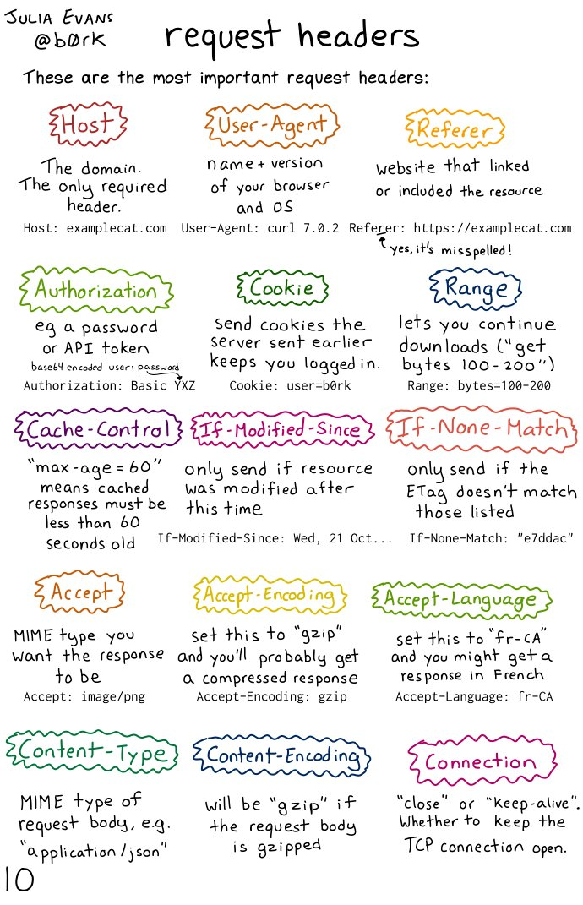

Slide 32
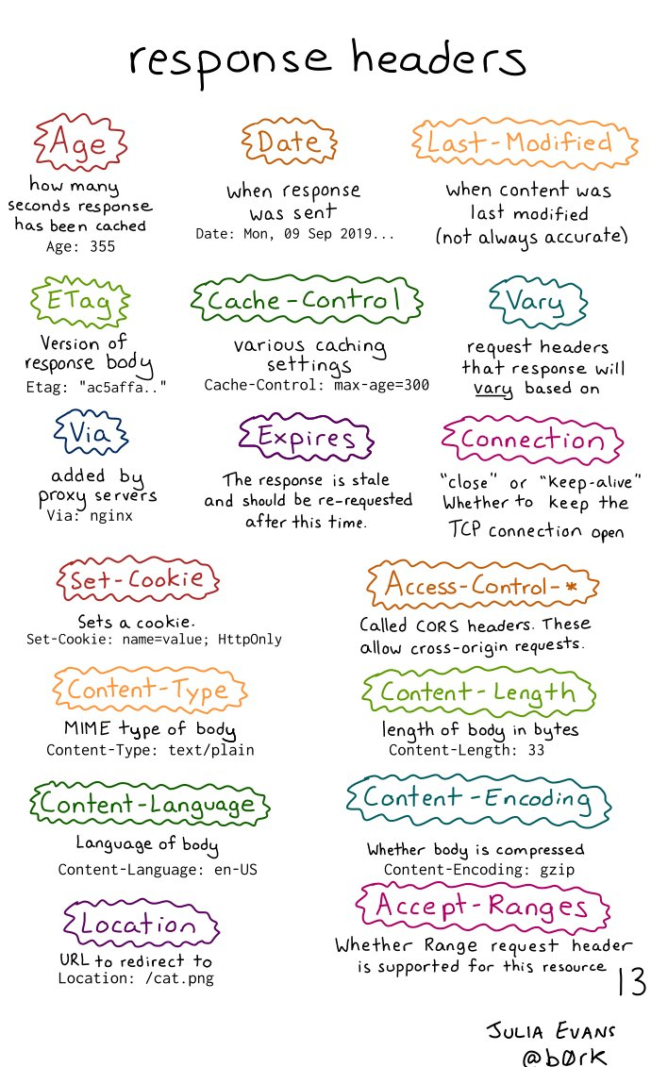

Slide 33
Trying out HTTP (client side) for yourself
1. netcat to your favorite Web server:
% nc -c -v gaia.cs.umass.edu 80
opens TCP connection to port 80 (default HTTP server port) at gaia.cs.umass. edu.
anything typed in will be sent to port 80 at gaia.cs.umass.edu
2. type in a GET HTTP request:
GET /kurose_ross/interactive/index.php HTTP/1.1
Host: gaia.cs.umass.edu
by typing this in (hit carriage return twice), you send this minimal (but complete) GET request to HTTP server
3. look at response message sent by HTTP server!
(or use Wireshark to look at captured HTTP request/response)

Slide 34
Trying out HTTP
Telnet
HTTPClient.java
https://gist.github.com/khalefa-ow/500209741080f2bf2c4fd8c51977a40a

Slide 35

Maintaining user/server state: cookies
Recall: HTTP GET/response interaction is stateless
no notion of multi-step exchanges of HTTP messages to complete a Web “transaction”
  no need for client/server to track “state” of multi-step exchange
  all HTTP requests are independent of each other
  no need for client/server to “recover” from a partially-completed-but-never-completely-completed transaction
a stateful protocol: client makes two changes to X, or none at all
X
lock data record X
X
OK
update X X’
X’
OK
t’
update X X’’
OK
X’’
unlock X
OK
X’’
time
time
Q: what happens if network connection or client crashes at t’ ?
Notes:
t’

Slide 36
Maintaining user/server state: cookies
Web sites and client browser use cookies to maintain some state between transactions
four components:
  1) cookie header line of HTTP response message
  2) cookie header line in next HTTP request message
  3) cookie file kept on user’s host, managed by user’s browser
  4) back-end database at Web site
Example:
Susan uses browser on laptop, visits specific e-commerce site for first time
when initial HTTP requests arrives at site, site creates:
  unique ID (aka “cookie”)
  entry in backend database for ID
subsequent HTTP requests from Susan to this site will contain cookie ID value, allowing site to “identify” Susan
Notes:
t’

Slide 37
Maintaining user/server state: cookies
client
server
ebay 8734
usual HTTP request msg
Amazon server
creates ID
1678 for user
cookie file
usual HTTP response
set-cookie: 1678
backend
database
create
entry
ebay 8734
amazon 1678
usual HTTP request msg
cookie: 1678
cookie-
specific
action
access
usual HTTP response msg
one week later:
access
ebay 8734
amazon 1678
usual HTTP request msg
cookie: 1678
cookie-
specific
action
usual HTTP response msg
time
time
Notes:
t’

Slide 38
HTTP cookies: comments
aside
What cookies can be used for:
authorization
shopping carts
recommendations
user session state (Web e-mail)
cookies and privacy:
cookies permit sites to learn a lot about you on their site.
third party persistent cookies (tracking cookies) allow common identity (cookie value) to be tracked across multiple web sites
Challenge: How to keep state?
at protocol endpoints: maintain state at sender/receiver over multiple transactions
in messages: cookies inHTTP messages carry state
Notes:
t’

Slide 39

3rd Party Cookies
How Are Third-Party Cookies Created on a Website?

Slide 40

Web caches
Goal: satisfy client requests without involving origin server
user configures browser to point to a (local) Web cache
browser sends all HTTP requests to cache
  if object in cache: cache returns object to client
  else cache requests object from origin server, caches received object, then returns object to client
Web
cache
HTTP request
HTTP request
client
HTTP response
HTTP response
origin
server
HTTP request
HTTP response
client
Notes:
t’

Slide 41


Web caches (aka proxy servers)
Web cache acts as both client and server
  server for original requesting client
  client to origin server
Why Web caching?
reduce response time for client request
  cache is closer to client
reduce traffic on an institution’s access link
Internet is dense with caches
  enables “poor” content providers to more effectively deliver content
server tells cache about object’s allowable caching in response header:
Notes:
re: poor content providers – like in real-estate, location is everything. servers want to be close to clients.

Slide 42
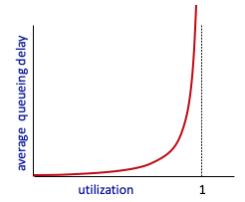


Caching example
Scenario:
access link rate: 1.54 Mbps
RTT from institutional router to server: 2 sec
web object size: 100K bits
average request rate from browsers to origin servers: 15/sec
  avg data rate to browsers: 1.50 Mbps
origin
servers
public
Internet
1.54 Mbps
access link
Performance:
access link utilization = .97
LAN utilization: .0015
end-end delay = Internet delay +
access link delay + LAN delay
= 2 sec + minutes + usecs
problem: large queueing delays at high utilization!
institutional
network
1 Gbps LAN
Notes:
explain why minutes (recall earlier delay versus arrival rate curve from Chapter 1)

Slide 43
Option 1: buy a faster access link
Scenario:
access link rate: 1.54 Mbps
RTT from institutional router to server: 2 sec
web object size: 100K bits
average request rate from browsers to origin servers: 15/sec
  avg data rate to browsers: 1.50 Mbps
154 Mbps
origin
servers
public
Internet
154 Mbps
1.54 Mbps
access link
Performance:
access link utilization = .97
LAN utilization: .0015
end-end delay = Internet delay +
access link delay + LAN delay
= 2 sec + minutes + usecs
.0097
institutional
network
1 Gbps LAN
Cost: faster access link (expensive!)
msecs
Notes:
t’

Slide 44
Option 2: install a web cache
Scenario:
access link rate: 1.54 Mbps
RTT from institutional router to server: 2 sec
web object size: 100K bits
average request rate from browsers to origin servers: 15/sec
  avg data rate to browsers: 1.50 Mbps
origin
servers
public
Internet
1.54 Mbps
access link
Cost: web cache (cheap!)
institutional
network
Performance:
LAN utilization: .?
access link utilization = ?
average end-end delay = ?
1 Gbps LAN
How to compute link
utilization, delay?
local web cache
Notes:
t’

Slide 45
Calculating access link utilization, end-end delay with cache:
suppose cache hit rate is 0.4:
40% requests served by cache, with low (msec) delay
origin
servers
public
Internet
60% requests satisfied at origin
  rate to browsers over access link
  = 0.6 * 1.50 Mbps = .9 Mbps
  access link utilization = 0.9/1.54 = .58 means low (msec) queueing delay at access link
1.54 Mbps
access link
institutional
network
average end-end delay:
  = 0.6 * (delay from origin servers)
  + 0.4 * (delay when satisfied at cache)
  = 0.6 (2.01) + 0.4 (~msecs) = ~ 1.2 secs
1 Gbps LAN
local web cache
lower average end-end delay than with 154 Mbps link (and cheaper too!)
Notes:
t’

Slide 46
Conditional GET
client
server
Goal: don’t send object if cache has up-to-date cached version
  no object transmission delay (or use of network resources)
client: specify date of cached copy in HTTP request
  If-modified-since: <date>
server: response contains no object if cached copy is up-to-date:
  HTTP/1.0 304 Not Modified
HTTP request msg
If-modified-since: <date>
object
not
modified
before
<date>
HTTP response
HTTP/1.0
304 Not Modified
HTTP request msg
If-modified-since: <date>
object
modified
after
<date>
HTTP response
HTTP/1.0 200 OK
<data>
Notes:
t’

Slide 47
HTTP/2
Key goal: decreased delay in multi-object HTTP requests
HTTP1.1: introduced multiple, pipelined GETs over single TCP connection
server responds in-order (FCFS: first-come-first-served scheduling) to GET requests
with FCFS, small object may have to wait for transmission (head-of-line (HOL) blocking) behind large object(s)
loss recovery (retransmitting lost TCP segments) stalls object transmission
Notes:
t’

Slide 48
HTTP/2
Key goal: decreased delay in multi-object HTTP requests
HTTP/2: [RFC 7540, 2015] increased flexibility at server in sending objects to client:
methods, status codes, most header fields unchanged from HTTP 1.1
transmission order of requested objects based on client-specified object priority (not necessarily FCFS)
push unrequested objects to client
divide objects into frames, schedule frames to mitigate HOL blocking
Notes:
t’

Slide 49
HTTP/2: mitigating HOL blocking
HTTP 1.1: client requests 1 large object (e.g., video file) and 3 smaller objects
server
GET O₄
GET O₃
GET O₂
GET O₁
object data requested
client
O₁
O₂
O₁
O₃
O₂
O₃
O₄
O₄
objects delivered in order requested: O₂, O₃, O₄ wait behind O₁
Notes:
t’

Slide 50
HTTP/2: mitigating HOL blocking
HTTP/2: objects divided into frames, frame transmission interleaved
server
GET O₄
GET O₃
GET O₂
GET O₁
object data requested
client
O₂
O₄
O₃
O₁
O₂
O₃
O₄
O₁
O₂, O₃, O₄ delivered quickly, O₁ slightly delayed
Notes:
shortest job first: decreased average delay!

Slide 51
HTTP/2 to HTTP/3
HTTP/2 over single TCP connection means:
recovery from packet loss still stalls all object transmissions
  as in HTTP 1.1, browsers have incentive to open multiple parallel TCP connections to reduce stalling, increase overall throughput
no security over vanilla TCP connection
HTTP/3: adds security, per object error- and congestion-control (more pipelining) over UDP
  more on HTTP/3 in transport layer
Notes:
t’

Slide 52
Application layer: overview
P2P applications
video streaming and content distribution networks
socket programming with UDP and TCP
Principles of network applications
Web and HTTP
E-mail, SMTP, IMAP
The Domain Name System DNS

Slide 53
E-mail
user
agent
Three major components:
user agents
mail servers
simple mail transfer protocol: SMTP
User Agent
a.k.a. “mail reader”
composing, editing, reading mail messages
e.g., Outlook, iPhone mail client
outgoing, incoming messages stored on server
mail
server
user
agent
SMTP
mail
server
user
agent
SMTP
SMTP
user
agent
mail
server
user
agent
user
agent
outgoing
message queue
user mailbox

Slide 54
E-mail: mail servers
user
agent
mail servers:
mailbox contains incoming messages for user
message queue of outgoing (to be sent) mail messages
SMTP protocol between mail servers to send email messages
client: sending mail server
“server”: receiving mail server
mail
server
user
agent
SMTP
mail
server
user
agent
SMTP
SMTP
user
agent
mail
server
user
agent
user
agent
outgoing
message queue
user mailbox

Slide 55
SMTP RFC (5321)
“client”
SMTP server
“server”
SMTP server
uses TCP to reliably transfer email message from client (mail server initiating connection) to server, port 25
  direct transfer: sending server (acting like client) to receiving server
three phases of transfer
  SMTP handshaking (greeting)
  SMTP transfer of messages
  SMTP closure
command/response interaction (like HTTP)
  commands: ASCII text
  response: status code and phrase
initiate TCP
connection
RTT
TCP connection
initiated
220
SMTP handshaking
HELO
250 Hello
SMTP transfers
time

Slide 56


Scenario: Alice sends e-mail to Bob
1) Alice uses UA to compose e-mail message “to” bob@someschool.edu
4) SMTP client sends Alice’s message over the TCP connection
2) Alice’s UA sends message to her mail server using SMTP; message placed in message queue
5) Bob’s mail server places the message in Bob’s mailbox
3) client side of SMTP at mail server opens TCP connection with Bob’s mail server
6) Bob invokes his user agent to read message
user
agent
mail
server
user
agent
1
mail
server
2
3
6
4
Alice’s mail server
5
Bob’s mail server

Slide 57
Sample SMTP interaction
S: 220 hamburger.edu
C: HELO crepes.fr
S: 250 Hello crepes.fr, pleased to meet you
C: MAIL FROM: <alice@crepes.fr>
S: 250 alice@crepes.fr... Sender ok
C: RCPT TO: <bob@hamburger.edu>
S: 250 bob@hamburger.edu ... Recipient ok
C: DATA
S: 354 Enter mail, end with "." on a line by itself
C: Do you like ketchup?
C: How about pickles?
C: .
S: 250 Message accepted for delivery
C: QUIT
S: 221 hamburger.edu closing connection

Slide 58
SMTP: observations
comparison with HTTP:
HTTP: client pull
SMTP: client push
both have ASCII command/response interaction, status codes
HTTP: each object encapsulated in its own response message
SMTP: multiple objects sent in multipart message
SMTP uses persistent connections
SMTP requires message (header & body) to be in 7-bit ASCII
SMTP server uses CRLF.CRLF to determine end of message

Slide 59
Mail message format
SMTP: protocol for exchanging e-mail messages, defined in RFC 5321 (like RFC 7231 defines HTTP)
RFC 2822 defines syntax for e-mail message itself (like HTML defines syntax for web documents)
header lines, e.g.,
  To:
  From:
  Subject:
  these lines, within the body of the email message area different from SMTP MAIL FROM:, RCPT TO: commands!
Body: the “message” , ASCII characters only
header
blank
line
body

Slide 60
Retrieving email: mail access protocols
user
agent
e-mail access
protocol
user
agent
SMTP
SMTP
(e.g., IMAP, HTTP)
sender’s e-mail
server
receiver’s e-mail
server
SMTP: delivery/storage of e-mail messages to receiver’s server
mail access protocol: retrieval from server
  IMAP: Internet Mail Access Protocol [RFC 3501]: messages stored on server, IMAP provides retrieval, deletion, folders of stored messages on server
HTTP: gmail, Hotmail, Yahoo!Mail, etc. provides web-based interface on top of STMP (to send), IMAP (or POP) to retrieve e-mail messages

Slide 61
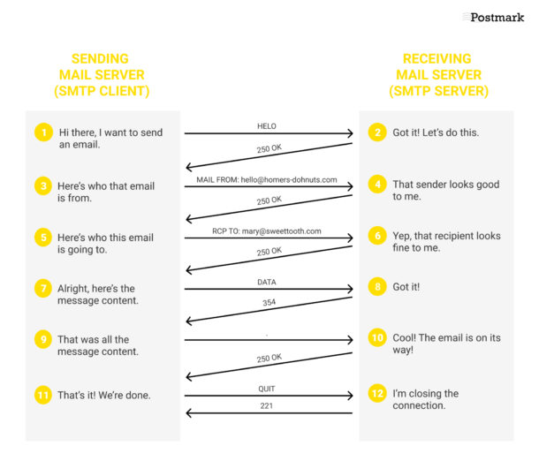
Notes:
From: https://postmarkapp.com/guides/everything-you-need-to-know-about-smtp

Slide 62
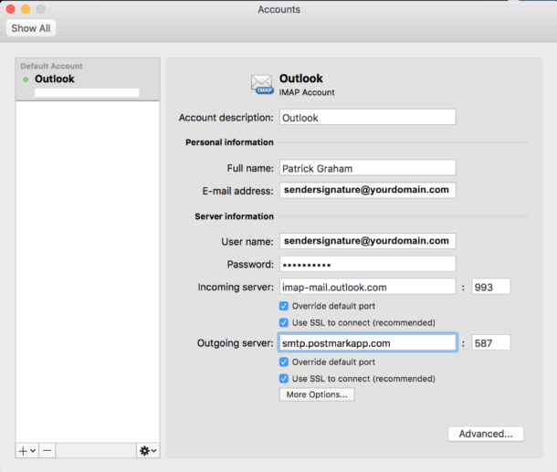

Slide 63
Application Layer: Overview
P2P applications
video streaming and content distribution networks
socket programming with UDP and TCP
Principles of network applications
Web and HTTP
E-mail, SMTP, IMAP
The Domain Name System DNS

Slide 64
DNS: Domain Name System
people: many identifiers:
  SSN, name, passport #
Internet hosts, routers:
  IP address (32 bit) - used for addressing datagrams
  “name”, e.g., cs.umass.edu - used by humans
Q: how to map between IP address and name, and vice versa ?
Domain Name System (DNS):
distributed database implemented in hierarchy of many name servers
application-layer protocol: hosts, DNS servers communicate to resolve names (address/name translation)
  note: core Internet function, implemented as application-layer protocol
  complexity at network’s “edge”

Slide 65
DNS: services, structure
DNS services:
hostname-to-IP-address translation
host aliasing
  canonical, alias names
mail server aliasing
load distribution
  replicated Web servers: many IP addresses correspond to one name
Q: Why not centralize DNS?
single point of failure
traffic volume
distant centralized database
maintenance
A: doesn‘t scale!
Comcast DNS servers alone: 600B DNS queries/day
Akamai DNS servers alone: 2.2T DNS queries/day

Slide 66

Thinking about the DNS
humongous distributed database:
~ billion records, each simple
handles many trillions of queries/day:
many more reads than writes
performance matters: almost every Internet transaction interacts with DNS - msecs count!
organizationally, physically decentralized:
millions of different organizations responsible for their records
“bulletproof”: reliability, security

Slide 67
DNS: a distributed, hierarchical database
Root DNS Servers
Root
…
…
.com DNS servers
.org DNS servers
.edu DNS servers
Top Level Domain
…
…
…
…
yahoo.com
DNS servers
amazon.com
DNS servers
pbs.org
DNS servers
nyu.edu
DNS servers
umass.edu
DNS servers
Authoritative
Client wants IP address for www.amazon.com; 1st approximation:
client queries root server to find .com DNS server
client queries .com DNS server to get amazon.com DNS server
client queries amazon.com DNS server to get IP address for www.amazon.com

Slide 68
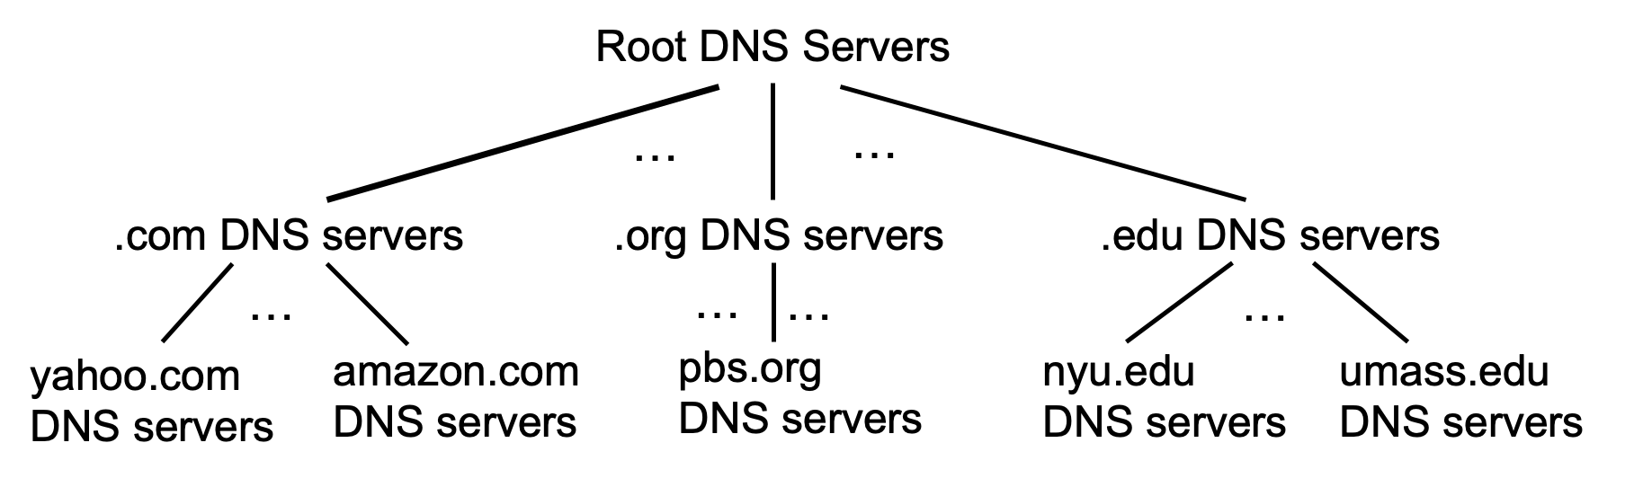
DNS: root name servers
official, contact-of-last-resort by name servers that can not resolve name

Slide 69
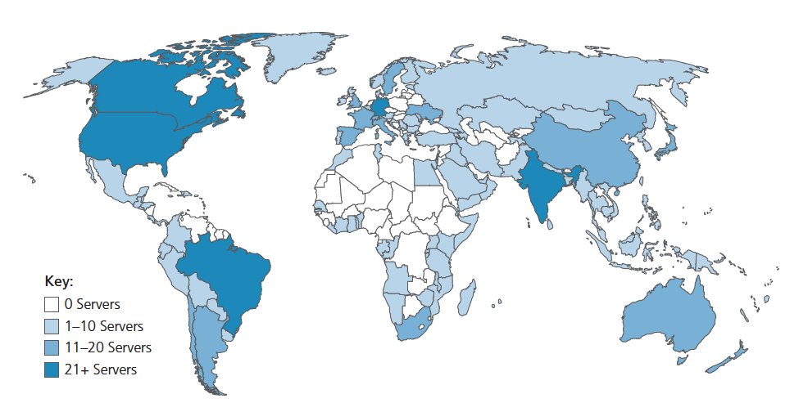
DNS: root name servers
official, contact-of-last-resort by name servers that can not resolve name
incredibly important Internet function
  Internet couldn’t function without it!
  DNSSEC – provides security (authentication, message integrity)
ICANN (Internet Corporation for Assigned Names and Numbers) manages root DNS domain
13 logical root name “servers” worldwide each “server” replicated many times (~200 servers in US)

Slide 70
Top-Level Domain, and authoritative servers
Top-Level Domain (TLD) servers:
  responsible for .com, .org, .net, .edu, .aero, .jobs, .museums, and all top-level country domains, e.g.: .cn, .uk, .fr, .ca, .jp
  Network Solutions: authoritative registry for .com, .net TLD
  Educause: .edu TLD
authoritative DNS servers:
  organization’s own DNS server(s), providing authoritative hostname to IP mappings for organization’s named hosts
  can be maintained by organization or service provider

Slide 71
Local DNS name servers
when host makes DNS query, it is sent to its local DNS server
  Local DNS server returns reply, answering:
    from its local cache of recent name-to-address translation pairs (possibly out of date!)
    forwarding request into DNS hierarchy for resolution
  each ISP has local DNS name server; to find yours:
    MacOS: % scutil --dns
    Windows: >ipconfig /all
local DNS server doesn’t strictly belong to hierarchy

Slide 72
DNS name resolution: iterated query
root DNS server
Example: host at engineering.nyu.edu wants IP address for gaia.cs.umass.edu
2
3
TLD DNS server
Iterated query:
contacted server replies with name of server to contact
“I don’t know this name, but ask this server”
1
4
8
5
requesting host at
engineering.nyu.edu
local DNS server
dns.nyu.edu
gaia.cs.umass.edu
7
6
authoritative DNS server
dns.cs.umass.edu

Slide 73
DNS name resolution: recursive query
root DNS server
Example: host at engineering.nyu.edu wants IP address for gaia.cs.umass.edu
2
3
7
6
Recursive query:
puts burden of name resolution on contacted name server
heavy load at upper levels of hierarchy?
1
TLD DNS server
8
requesting host at
engineering.nyu.edu
local DNS server
dns.nyu.edu
5
4
gaia.cs.umass.edu
authoritative DNS server
dns.cs.umass.edu

Slide 74
Caching DNS Information
once (any) name server learns mapping, it caches mapping, and immediately returns a cached mapping in response to a query
  caching improves response time
  cache entries timeout (disappear) after some time (TTL)
  TLD servers typically cached in local name servers
cached entries may be out-of-date
  if named host changes IP address, may not be known Internet-wide until all TTLs expire!
  best-effort name-to-address translation!

Slide 75
DNS records
DNS: distributed database storing resource records (RR)
RR format: (name, value, type, ttl)
type=A
  name is hostname
  value is IP address
type=CNAME
  name is alias name for some “canonical” (the real) name
  www.ibm.com is really servereast.backup2.ibm.com
  value is canonical name
type=NS
  name is domain (e.g., foo.com)
  value is hostname of authoritative name server for this domain
type=MX
  value is name of SMTP mail server associated with name

Slide 76
DNS protocol messages
DNS query and reply messages, both have same format:
2 bytes
2 bytes
message header:
identification: 16 bit # for query, reply to query uses same #
flags:
  query or reply
  recursion desired
  recursion available
  reply is authoritative
identification
flags
# questions
# answer RRs
# authority RRs
# additional RRs
questions (variable # of questions)
answers (variable # of RRs)
authority (variable # of RRs)
additional info (variable # of RRs)

Slide 77
DNS protocol messages
DNS query and reply messages, both have same format:
2 bytes
2 bytes
identification
flags
# questions
# answer RRs
# authority RRs
# additional RRs
name, type fields for a query
questions (variable # of questions)
RRs in response to query
answers (variable # of RRs)
records for authoritative servers
authority (variable # of RRs)
additional “ helpful” info that may be used
additional info (variable # of RRs)

Slide 78
Getting your info into the DNS
example: new startup “Network Utopia”
register name networkuptopia.com at DNS registrar (e.g., Network Solutions)
  provide names, IP addresses of authoritative name server (primary and secondary)
  registrar inserts NS, A RRs into .com TLD server:
  (networkutopia.com, dns1.networkutopia.com, NS)
  (dns1.networkutopia.com, 212.212.212.1, A)
create authoritative server locally with IP address 212.212.212.1
  type A record for www.networkuptopia.com
  type MX record for networkutopia.com

Slide 79
DNS security
DDoS attacks
bombard root servers with traffic
  not successful to date
  traffic filtering
  local DNS servers cache IPs of TLD servers, allowing root server bypass
bombard TLD servers
  potentially more dangerous
Spoofing attacks
intercept DNS queries, returning bogus replies
  DNS cache poisoning
  RFC 4033: DNSSEC authentication services

Slide 80
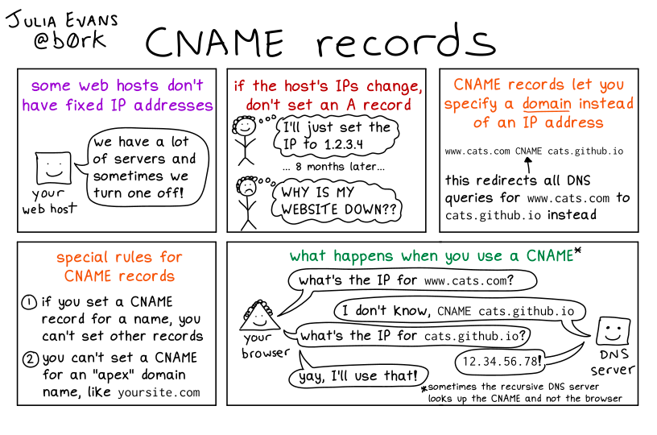
CNAME Records

Slide 81
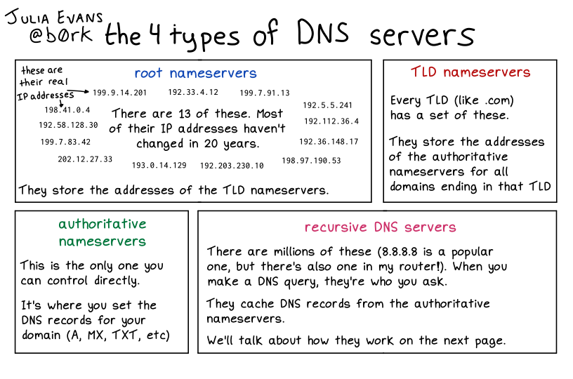
DNS Types

Slide 82
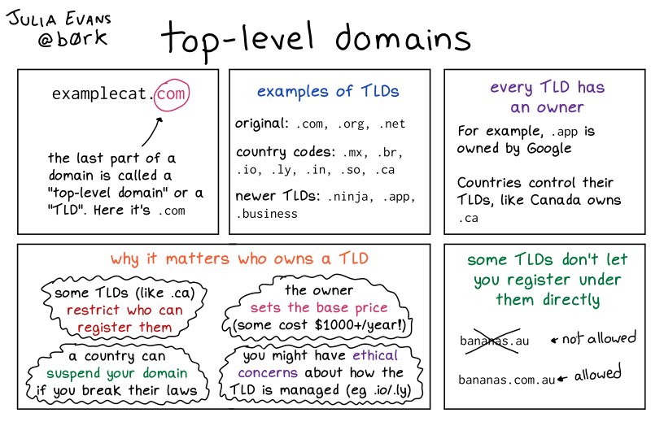

Slide 83
Application Layer: Overview
P2P applications
video streaming and content distribution networks
socket programming with UDP and TCP
Principles of network applications
Web and HTTP
E-mail, SMTP, IMAP
The Domain Name System DNS

Slide 84
Peer-to-peer (P2P) architecture
no always-on server
arbitrary end systems directly communicate
peers request service from other peers, provide service in return to other peers
  self scalability – new peers bring new service capacity, and new service demands
peers are intermittently connected and change IP addresses
  complex management
examples: P2P file sharing (BitTorrent), streaming (KanKan), VoIP (Skype)
mobile network
national or global ISP
local or regional ISP
home network
content
provider
network
datacenter
network
enterprise
network

Slide 85
File distribution: client-server vs P2P
Q: how much time to distribute file (size F) from one server to N peers?
  peer upload/download capacity is limited resource
u_{s}: server upload capacity
d_{i}: peer i download capacity
file, size F
u₁
d₁
u₂
u_{s}
d₂
server
d_{i}
u_{N}
network (with abundant
bandwidth)
u_{i}
d_{N}
u_{i}: peer i upload capacity

Slide 86
File distribution time: client-server
server transmission: must sequentially send (upload) N file copies:
  time to send one copy: F/u_{s}
  time to send N copies: NF/u_{s}
F
u_{s}
d_{i}
network
client: each client must download file copy
  d_{min} = min client download rate
  min client download time: F/d_{min}
u_{i}
time to distribute F
to N clients using
client-server approach
D_{c-s} > max{NF/u_{s,},F/d_{min}}
increases linearly in N

Slide 87
File distribution time: P2P
server transmission: must upload at least one copy:
  time to send one copy: F/u_{s}
F
u_{s}
client: each client must download file copy
  min client download time: F/d_{min}
d_{i}
network
u_{i}
clients: as aggregate must download NF bits
  max upload rate (limiting max download rate) is u_{s} + Σu_{i}
time to distribute F
to N clients using
P2P approach
D_{P2P} > max{F/u_{s,},F/d_{min,},NF/(u_{s} + Σu_{i})}
increases linearly in N …
… but so does this, as each peer brings service capacity

Slide 88
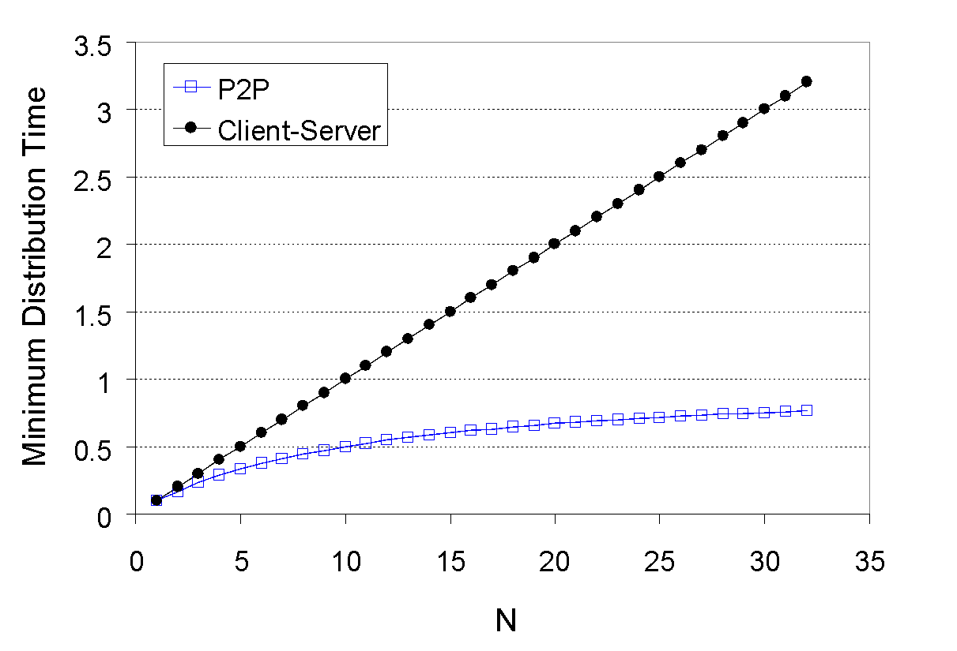
Client-server vs. P2P: example
client upload rate = u, F/u = 1 hour, u_{s} = 10u, d_{min} ≥ u_{s}

Slide 89

P2P file distribution: BitTorrent
file divided into 256KB chunks
peers in torrent send/receive file chunks
tracker: tracks peers
participating in torrent
torrent: group of peers exchanging chunks of a file
Alice arrives …
… obtains list
of peers from tracker
… and begins exchanging
file chunks with peers in torrent

Slide 90


P2P file distribution: BitTorrent
peer joining torrent:
  has no chunks, but will accumulate them over time from other peers
  registers with tracker to get list of peers, connects to subset of peers (“neighbors”)
while downloading, peer uploads chunks to other peers
peer may change peers with whom it exchanges chunks
churn: peers may come and go
once peer has entire file, it may (selfishly) leave or (altruistically) remain in torrent

Slide 91
BitTorrent: requesting, sending file chunks
Requesting chunks:
at any given time, different peers have different subsets of file chunks
periodically, Alice asks each peer for list of chunks that they have
Alice requests missing chunks from peers, rarest first
Sending chunks: tit-for-tat
Alice sends chunks to those four peers currently sending her chunks at highest rate
  other peers are choked by Alice (do not receive chunks from her)
  re-evaluate top 4 every10 secs
every 30 secs: randomly select another peer, starts sending chunks
  “optimistically unchoke” this peer
  newly chosen peer may join top 4

Slide 92
BitTorrent: tit-for-tat
(1) Alice “optimistically unchokes” Bob
(2) Alice becomes one of Bob’s top-four providers; Bob reciprocates
(3) Bob becomes one of Alice’s top-four providers
higher upload rate: find better trading partners, get file faster !

Slide 93
Application layer: overview
P2P applications
video streaming and content distribution networks
socket programming with UDP and TCP
Principles of network applications
Web and HTTP
E-mail, SMTP, IMAP
The Domain Name System DNS

Slide 94




Video Streaming and CDNs: context
stream video traffic: major consumer of Internet bandwidth
  Netflix, YouTube, Amazon Prime: 80% of residential ISP traffic (2020)
challenge: scale - how to reach ~1B users?
challenge: heterogeneity
  different users have different capabilities (e.g., wired versus mobile; bandwidth rich versus bandwidth poor)
solution: distributed, application-level infrastructure

Slide 95

Multimedia: video
spatial coding example: instead of sending N values of same color (all purple), send only two values: color value (purple) and number of repeated values (N)
video: sequence of images displayed at constant rate
  e.g., 24 images/sec
digital image: array of pixels
  each pixel represented by bits
coding: use redundancy within and between images to decrease # bits used to encode image
  spatial (within image)
  temporal (from one image to next)
……………………..
……………….…….
frame i
temporal coding example: instead of sending complete frame at i+1, send only differences from frame i
frame i+1

Slide 96
Multimedia: video
spatial coding example: instead of sending N values of same color (all purple), send only two values: color value (purple) and number of repeated values (N)
CBR: (constant bit rate): video encoding rate fixed
VBR: (variable bit rate): video encoding rate changes as amount of spatial, temporal coding changes
examples:
  MPEG 1 (CD-ROM) 1.5 Mbps
  MPEG2 (DVD) 3-6 Mbps
  MPEG4 (often used in Internet, 64Kbps – 12 Mbps)
……………………..
……………….…….
frame i
temporal coding example: instead of sending complete frame at i+1, send only differences from frame i
frame i+1

Slide 97


Streaming stored video
simple scenario:
Internet
video server
(stored video)
client
Main challenges:
server-to-client bandwidth will vary over time, with changing network congestion levels (in house, access network, network core, video server)
packet loss, delay due to congestion will delay playout, or result in poor video quality

Slide 98
Streaming stored video
Cumulative data
2. video
sent
video
recorded (e.g., 30 frames/sec)
3. video received, played out at client
(30 frames/sec)
network delay
(fixed in this example)
time
streaming: at this time, client playing out early part of video, while server still sending later part of video

Slide 99
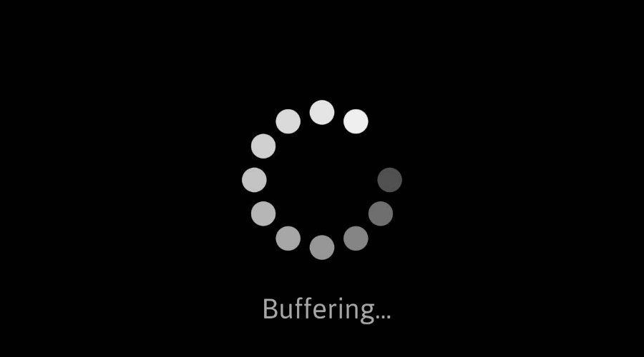
Streaming stored video: challenges
continuous playout constraint: during client video playout, playout timing must match original timing
  … but network delays are variable (jitter), so will need client-side buffer to match continuous playout constraint
other challenges:
  client interactivity: pause, fast-forward, rewind, jump through video
  video packets may be lost, retransmitted

Slide 100
Streaming stored video: playout buffering
constant bit
rate video
transmission
client video
reception
constant bit
rate video
playout at client
Cumulative data
variable
network
delay
buffered
video
client playout
delay
time
client-side buffering and playout delay: compensate for network-added delay, delay jitter

Slide 101
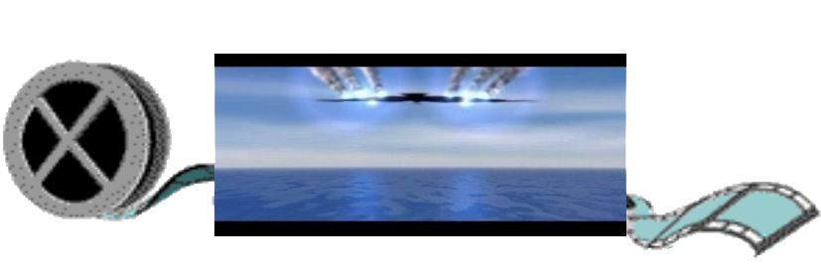
Streaming multimedia: DASH
Dynamic, Adaptive Streaming over HTTP
server:
  divides video file into multiple chunks
  each chunk encoded at multiple different rates
  different rate encodings stored in different files
  files replicated in various CDN nodes
  manifest file: provides URLs for different chunks
...
...
?
...
client
client:
  periodically estimates server-to-client bandwidth
  consulting manifest, requests one chunk at a time
    chooses maximum coding rate sustainable given current bandwidth
    can choose different coding rates at different points in time (depending on available bandwidth at time), and from different servers

Slide 102

Streaming multimedia: DASH
“intelligence” at client: client determines
  when to request chunk (so that buffer starvation, or overflow does not occur)
  what encoding rate to request (higher quality when more bandwidth available)
...
...
?
...
client
  where to request chunk (can request from URL server that is “close” to client or has high available bandwidth)
Streaming video = encoding + DASH + playout buffering

Slide 103
Content distribution networks (CDNs)
challenge: how to stream content (selected from millions of videos) to hundreds of thousands of simultaneous users?
option 1: single, large “mega-server”
  single point of failure
  point of network congestion
  long (and possibly congested) path to distant clients
….quite simply: this solution doesn’t scale

Slide 104


Content distribution networks (CDNs)
challenge: how to stream content (selected from millions of videos) to hundreds of thousands of simultaneous users?
option 2: store/serve multiple copies of videos at multiple geographically distributed sites (CDN)
  enter deep: push CDN servers deep into many access networks
    close to users
    Akamai: 240,000 servers deployed
    in > 120 countries (2015)
  bring home: smaller number (10’s) of larger clusters in POPs near access nets
    used by Limelight

Slide 105




Content distribution networks (CDNs)
CDN: stores copies of content (e.g. MADMEN) at CDN nodes
subscriber requests content, service provider returns manifest
  using manifest, client retrieves content at highest supportable rate
  may choose different rate or copy if network path congested
…
…
…
manifest file
…
where’s Madmen?
…
…
Notes:
‹#›
Akamai: 100,000+ servers in 1000+ clusters in 1000+ networks in 70+ countries serving trillions of requests a day.
How many people use Netflix?

Slide 106
Content distribution networks (CDNs)
OTT: “over the top”
…
…
Internet host-host communication as a service
…
…
OTT challenges: coping with a congested Internet from the “edge”
  what content to place in which CDN node?
  from which CDN node to retrieve content? At which rate?
…
…
Notes:
‹#›
peak load: 7million viewers, 2 Tbytes via

Slide 107
Application Layer: Overview
P2P applications
video streaming and content distribution networks
socket programming with UDP and TCP
Principles of network applications
Web and HTTP
E-mail, SMTP, IMAP
The Domain Name System DNS

Slide 108
Chapter 2: Summary
our study of network application layer is now complete!
application architectures
  client-server
  P2P
application service requirements:
  reliability, bandwidth, delay
Internet transport service model
  connection-oriented, reliable: TCP
  unreliable, datagrams: UDP
specific protocols:
  HTTP
  SMTP, IMAP
  DNS
  P2P: BitTorrent
video streaming, CDNs
socket programming:
TCP, UDP sockets

Slide 109
Chapter 2: Summary
Most importantly: learned about protocols!
typical request/reply message exchange:
  client requests info or service
  server responds with data, status code
message formats:
  headers: fields giving info about data
  data: info(payload) being communicated
important themes:
centralized vs. decentralized
stateless vs. stateful
scalability
reliable vs. unreliable message transfer
“complexity at network edge”

Slide 110
Additional Chapter 2 slides
Notes:
Version History
7.01 (January 2020)
All slides reformatted for 16:9 aspect ratio
Use of Calibri font, rather that Gill Sans MT
Updated slide content for 2020 link technologies and applications
Add more animation throughout
New Master slide

Slide 111
Sample SMTP interaction
S: 220 hamburger.edu
C: HELO crepes.fr
S: 250 Hello crepes.fr, pleased to meet you
C: MAIL FROM: <alice@crepes.fr>
S: 250 alice@crepes.fr... Sender ok
C: RCPT TO: <bob@hamburger.edu>
S: 250 bob@hamburger.edu ... Recipient ok
C: DATA
S: 354 Enter mail, end with "." on a line by itself
C: Do you like ketchup?
C: How about pickles?
C: .
S: 250 Message accepted for delivery
C: QUIT
S: 221 hamburger.edu closing connection
Notes:
Retired this slide, since telnet isn’t really used anymore, and few non https: mail servers around anymore....

Slide 112
CDN content access: a closer look
Bob (client) requests video http://netcinema.com/6Y7B23V
video stored in CDN at http://KingCDN.com/NetC6y&B23V
1. Bob gets URL for video http://netcinema.com/6Y7B23V
from netcinema.com web page
2. resolve http://netcinema.com/6Y7B23V
via Bob’s local DNS
1
2
6. request video from
KINGCDN server,
streamed via HTTP
5
Bob’s
local DNS
server
netcinema.com
3. netcinema’s DNS returns CNAME for
http://KingCDN.com/NetC6y&B23V
4
3
netcinema’s
authoratative DNS
KingCDN.com
KingCDN
authoritative DNS
Notes:
This slide retired, since there’s the Netflix example which is visually better

Slide 113
Case study: Netflix
Amazon cloud
upload copies of multiple versions of video to CDN servers
CDN
server
Netflix registration,
accounting servers
Bob browses
Netflix video
Manifest file, requested
returned for
specific video
CDN
server
2
1
3
Bob manages Netflix account
CDN
server
4
DASH server selected, contacted, streaming begins
Notes:
This slide retired, since there’s the new Netflix example which is visually better

Slide 114
Additional Materials

Slide 115
Representational State Transfer (REST):
Representing Information in Web 2.0 Applications
Notes:
From: Emilio F Zegarra

Slide 116
Hypertext Transfer Protocol (HTTP)
A communications protocol
Allows retrieving inter-linked text documents (hypertext)
  World Wide Web.
HTTP Verbs
  HEAD
  GET
  POST
  PUT
  DELETE
  TRACE
  OPTIONS
  CONNECT
GET /index.html HTTP/1.1
Host: www.pitt.edu
Browser
Web Server
HTTP/1.1 200 OK
Content-Type: text/html
<html><head>…

Slide 117
Representational State Transfer (REST)
A style of software architecture for distributed hypermedia systems such as the World Wide Web.
Introduced in the doctoral dissertation of Roy Fielding
  One of the principal authors of the HTTP specification.
A collection of network architecture principles which outline how resources are defined and addressed
Notes:
this is the presentation

Slide 118
REST and HTTP
The motivation for REST was to capture the characteristics of the Web which made the Web successful.
  URI Addressable resources
  HTTP Protocol
  Make a Request – Receive Response – Display Response
Exploits the use of the HTTP protocol beyond HTTP POST and HTTP GET
  HTTP PUT, HTTP DELETE

Slide 119
REST - not a Standard
REST is not a standard
  JSR 311: JAX-RS: The JavaTM API for RESTful Web Services
But it uses several standards:
  HTTP
  URL
  XML/HTML/GIF/JPEG/etc (Resource Representations)
  text/xml, text/html, image/gif, image/jpeg, etc (Resource Types, MIME Types)

Slide 120
Main Concepts
Nouns (Resources)
unconstrained
i.e., http://example.com/employees/12345
REST
Verbs
constrained
i.e., GET
Representations
constrained
i.e., XML

Slide 121
Resources
The key abstraction of information in REST is a resource.
A resource is a conceptual mapping to a set of entities
  Any information that can be named can be a resource: a document or image, a temporal service (e.g. "today's weather in Los Angeles"), a collection of other resources, a non-virtual object (e.g. a person), and so on
Represented with a global identifier (URI in HTTP)
  http://www.boeing.com/aircraft/747

Slide 122
Naming Resources
REST uses URI to identify resources
  http://localhost/books/
  http://localhost/books/ISBN-0011
  http://localhost/books/ISBN-0011/authors
  http://localhost/classes
  http://localhost/classes/cs2650
  http://localhost/classes/cs2650/students
As you traverse the path from more generic to more specific, you are navigating the data

Slide 123
Verbs
Represent the actions to be performed on resources
HTTP GET
HTTP POST
HTTP PUT
HTTP DELETE

Slide 124
HTTP GET
How clients ask for the information they seek.
Issuing a GET request transfers the data from the server to the client in some representation
GET http://localhost/books
  Retrieve all books
GET http://localhost/books/ISBN-0011021
  Retrieve book identified with ISBN-0011021
GET http://localhost/books/ISBN-0011021/authors
  Retrieve authors for book identified with ISBN-0011021

Slide 125
HTTP PUT, HTTP POST
HTTP POST creates a resource
HTTP PUT updates a resource
POST http://localhost/books/
  Content: {title, authors[], …}
  Creates a new book with given properties
PUT http://localhost/books/isbn-111
  Content: {isbn, title, authors[], …}
  Updates book identified by isbn-111 with submitted properties

Slide 126
HTTP DELETE
Removes the resource identified by the URI
DELETE http://localhost/books/ISBN-0011
  Delete book identified by ISBN-0011

Slide 127
Representations
How data is represented or returned to the client for presentation.
Two main formats:
  JavaScript Object Notation (JSON)
  XML
It is common to have multiple representations of the same data

Slide 128
Representations
XML
  <COURSE>
    <ID>CS2650</ID>
    <NAME>Distributed Multimedia Software</NAME>
  </COURSE>
JSON
  {course
    {id: CS2650}
    {name: Distributed Multimedia Sofware}
  }

Slide 129
Why is it called
"Representational State Transfer"?
Resource
Client
http://www.boeing.com/aircraft/747
Fuel requirements
Maintenance schedule
...
Boeing747.html
The Client references a Web resource using a URL. A representation of the resource is returned (in this case as an HTML document).
The representation (e.g., Boeing747.html) places the client application in a state. The result of the client traversing a hyperlink in Boeing747.html is another resource accessed. The new representation places the client application into yet another state. Thus, the client application changes (transfers) state with each resource representation --> Representation State Transfer!

Slide 130
Architecture Style
Request
(XML doc)
HTTP GET
URL 1
doGet()
Response
(XML doc)
HTTP Response
doPost(id)
Request
(XML doc)
HTTP POST
URL 1
REST Engine
(locate resource and generate response)
Web/Proxy Server
Response
(JSON doc)
HTTP Response
doDelete()
PO
(XML doc)
HTTP DELETE
URL 1
Response
(TEXT doc)
HTTP Response

Slide 131
Real Life Examples
Google Maps
Google AJAX Search API
Yahoo Search API
Amazon WebServices

Slide 132
REST and the Web
The Web is an example of a REST system!
All of those Web services that you have been using all these many years - book ordering services, search services, online dictionary services, etc - are REST-based Web services.
Alas, you have been using REST, building REST services and you didn't even know it.

Slide 133
REST Implementations
Restlet
  http://www.restlet.org/
Project Zero
  http://www.projectzero.org
GlassFish Jersey
  https://jersey.dev.java.net/
JBoss RESTeasy
  http://www.jboss.org/resteasy/

Slide 134
My Project - Web 2.0 IC Card
Objective
  Transform the IC Card Application to support REST resources
  http://www.cs.pitt.edu/icms/iccards
  http://www.cs.pitt.edu/icms/iccards/001
  http://www.cs.pitt.edu/icms/groups/1/users

Slide 135

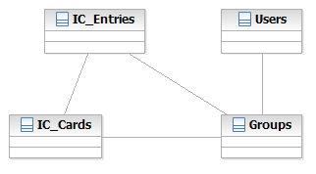







Invocation Model
http
http
Client
REST Service
SQL
Channels
Database

Slide 136
References
Representational State Transfer
http://en.wikipedia.org/wiki/Representational_State_Transfer
Roy Fieldings Thesis
http://www.ics.uci.edu/~fielding/pubs/dissertation/top.htm

